Slide 1
Samsung
Innovation
Campus
Artificial Intelligence Course

Slide 2
Chapter 6.
Machine Learning 2 - Unsupervised Learning
AI Course

Slide 3
Chapter Description
Chapter objectives
Be able to apply necessary machine learning techniques according to the established analysis plan.
Be able to apply various unsupervised learning techniques for data compression by reducing high-dimension data into low-dimension and data visualization by reducing dimensions.
Be able to solve problems by applying various clustering techniques for subject segmentation.
Be able to perform matrix decomposition and principal component analysis and applications.
Chapter contents
Unit 1. Unsupervised Machine Learning Algorithm
Unit 2. Hierarchical Clustering
Unit 3. Non-Hierarchical Clustering
Unit 4. Linear Factor Model for Dimensionality Reduction

Slide 4
Unit 1.
Unsupervised Machine Learning Algorithm
1.1. The Concept of Unsupervised Learning
1.2. Clustering Analysis

Slide 5
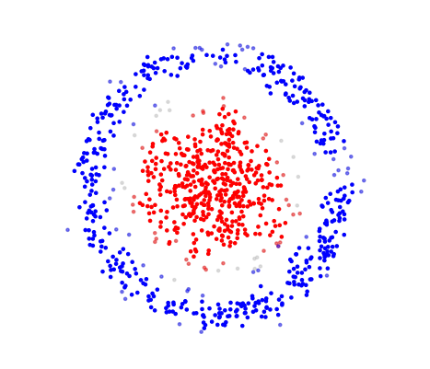
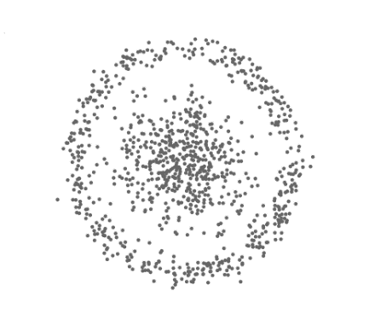
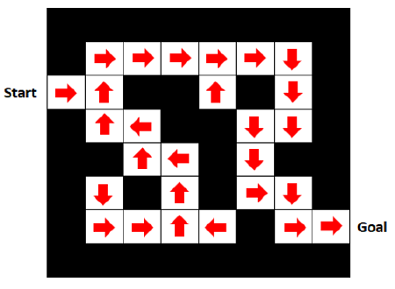
1.1. The Concept of Unsupervised Learning
UNIT 01
Machine Learning Types
Machine Learning
Supervised
Unsupervised
Reinforcement
Target pattern is given.
Target pattern must be found out.
Policy optimization
Notes:
It was mentioned that there are three main types of machine learning.
In this unit, we will see some concrete examples of the unsupervised learning.
This is the case where the response variable $Y$ does not exist and we should find out the hidden pattern.

Slide 6
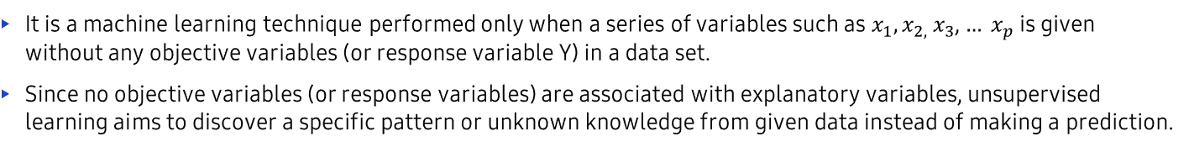
1.1. The Concept of Unsupervised Learning
UNIT 01
What is unsupervised learning?
The concept of unsupervised learning
It is a machine learning technique performed only when a series of variables such as $x_{1},x_{2, }x_{3}$, $… x_{p}$ is given without any objective variables (or response variable Y) in a data set.
Since no objective variables (or response variables) are associated with explanatory variables, unsupervised learning aims to discover a specific pattern or unknown knowledge from given data instead of making a prediction.
Notes:
The supervised machine learning technique that was learned from Chapter 5 has a clear objective which is to make classifications and value predictions depending on the types of objective variables (or response variables) and has clear evaluation criteria regarding analysis results such as cross-validation through data set division.
On the other hand, it is unclear what to discover in unsupervised learning, and because the target to be predicted is unknown, the computer program won’t be able to find actual answers. Thus, a problem of unsupervised learning is that it is difficult to investigate if the machine learning result is satisfactory or not.

Slide 7
1.1. The Concept of Unsupervised Learning
UNIT 01
What is unsupervised learning?
Machine learning for unsupervised learning
Clustering refers to making groups of similar objects or people according to the analysis purpose and algorithm.
Association refers to uncovering a co-occurrence relationship between specific items in a dataset.
Dimensionality reduction refers to summarizing a given variable set into a smaller number of variables for providing effective explanations.

Slide 8
Unit 1.
Unsupervised Machine Learning Algorithm
1.1. The Concept of Unsupervised Learning
1.2. Clustering Analysis

Slide 9
1.2. Clustering analysis
UNIT 01
What is clustering analysis?
Clustering is a technique that divides unlabeled and uncategorized data into similar groups based on the given observed values.
Problem
How to classify customers with similar characteristics into the same cluster
Select clustering analysis type
Select clustering variables
Analysis result
Inducing groups of customers with similar characteristics
Cluster 1
Cluster 2
Cluster 3
Application 1
Fragmentation of customers
Application 1
Additional analysis on each cluster
Understand demographic, social, and physical characteristics of each customer group.
Make the group profile and understand their characteristics.
Understand the overall data distribution.
Additional analysis on each cluster
Notes:
The main purpose of clustering analysis is to see how the input data forms groups. So, the criteria for grouping of input data are the first thing to consider in clustering analysis, and in general, data is grouped based on the similarity. In other words, the data within the cluster are very similar to each other, but their characteristics are different from those of other clusters.

Slide 10
1.2. Clustering analysis
UNIT 01
Clustering analysis
Clustering technique is the most common type of unsupervised learning. It groups unlabeled data into similar observed values based on suitable criteria.
Since clustering deals with unknown groups within the data, analysts cannot instruct the computer program what to find.
Thus, clustering is mainly used to figure out the attributes of different groups and give us insight into the underlying patterns of different groups rather than for making a prediction.
Notes:
So, clustering method is also referred to as unsupervised learning, and because of this it is closer to data mining to discover knowledge or unknown insight instead of the machine learning that tries to predict something by learning through data.

Slide 11
1.2. Clustering analysis
UNIT 01
Types of clustering analysis
Hierarchical clustering: divisive and agglomerative
Non-hierarchical clustering: the number of clusters is determined in advance.
Clustering analysis
Hierarchical
Non-hierarchical
Single-linkage, complete-linkage, average-linkage,
center-based, Ward’s method
K-means, Kohonen network

Slide 12
1.2. Clustering analysis
UNIT 01
Types of clustering analysis
In general, clustering analysis is classified into hierarchical clustering, non- hierarchical clustering, and partition-based clustering.
Non-Hierarchical Clustering (Partition-based Clustering) | K-means clustering
 | K-medoids clustering or PAM (Partitioning Around Method)
 | DBSCAN (Density Based Spatial Clustering of Application with Noise)
 | Self Organizing Map
 | Fuzzy clustering
Hierarchical Clustering | Agglomerative or bottom-up clustering
 | Divisive or top-down clustering
Mixture Distribution Clustering | Gaussian Mixture Model
Notes:
Many different methods are developed to overcome limitations or problems of K-means clustering.
In the actual big data environment, hierarchical clustering analysis is barely used because it requires extremely large amount of computing resources. Also, the mixture distribution clustering is not commonly used among business analysts as it demands a lot of background knowledge of inferential statistics including EM or MCMC predictions.
Therefore, non-hierarchical clustering is applied in the actual business environment most of the time, and K-means clustering is specifically widely used due to its simple usage.

Slide 13
1.2. Clustering analysis
UNIT 01
Application of clustering analysis
Identifying the pattern of unknown data groups in financial data analysis
Detecting any network intrusions (unauthorized penetration activities on a computer network)
Object and facial recognition from digital images
Clustering documents, music, or movies into different themes
Customer segmentation in the marketing field
Notes:
Clustering analysis can be applied in many different fields because it can make patterns based on data similarity or dissimilarity.

Slide 14
Unit 2.
Hierarchical Clustering
2.1. Hierarchical Method

Slide 15
2.1. Hierarchical Method
UNIT 02
Hierarchical method
Hierarchical method is useful for sorting clusters in the natural hierarchy structure. There are two hierarchical clustering methods, which are agglomerative and divisive clustering.
Agglomerative clustering
Bottom-Up
It starts with n-clusters to progressively agglomerate similar clusters until one final cluster remains.
Divisive clustering
Top-Down
It starts with a single cluster that includes all records and divides it into n-clusters (agglomerative clustering is a mainly used hierarchical method).
Notes:
Divisive clustering starts from a cluster that includes all samples, which is repeatedly divided into smaller clusters until one sample remains in the cluster.

Slide 16
2.1. Hierarchical Method
UNIT 02
How does agglomerative clustering work?
It starts with single-record clusters.
Pairs of similar clusters are merged until all clusters are merged into one big cluster containing all records.
What is agglomerative clustering algorithm?
It starts with n-clusters.
It merges two closest record clusters into one cluster.
Two closest clusters are merged in every step. This refers to adding single records to the existing cluster or combining two existing clusters.
Notes:
The advantage of hierarchical algorithm is that it doesn’t need to be designated with number of clusters in advance.

Slide 17
2.1. Hierarchical Method
UNIT 02
Agglomerative hierarchical clustering
Start: Each object is an individual atomic cluster.
Repetition: Repeated merging of two closest clusters
Finish: Generates a single cluster
X2
X2
X2
6
6
6
5
C
5
C
5
C
4
D
E
4
D
E
4
D
E
3
F
3
F
F
2
3
B
2
B
2
B
1
A
1
A
1
A
0
X1
0
X1
0
X1
0
2
4
6
0
2
4
6
0
2
4
6
X2
X2
X2
6
6
6
C
5
C
5
C
5
D
E
4
D
E
4
D
E
4
F
3
F
F
3
3
2
2
B
2
B
B
1
A
1
A
1
A
0
X1
0
X1
0
X1
0
2
4
6
0
2
4
6
0
2
4
6
Notes:
Hierarchical clustering analysis is useful to sort clusters in a natural hierarchy structure.

Slide 18
2.1. Hierarchical Method
UNIT 02
Hierarchical Clustering
About the hierarchical clustering
This is a unsupervised learning algorithm; there are only 𝑋 variables.
It is also called “agglomerative clustering.”
Nearest items are gathered to form ever growing clusters.
It can be visualized resembling an inverted tree-like structure called “dendrogram.”
Purpose of the hierarchical clustering
Cluster the observations into a given number of clusters.
Notes:
A different clustering algorithm is introduced.
This time around, it is the “hierarchical clustering.”

Slide 19
2.1. Hierarchical Method
UNIT 02
Pros
Intuitive interpretation of the results
Dendrogram that can be further processed to produce a desired number of clusters
Cons
A bit more time consuming than k-means
Notes:
The pros and cons of the hierarchical clustering are listed.
Another advantage of hierarchical clustering is that it doesn’t need to be designated with number of clusters in advance.

Slide 20
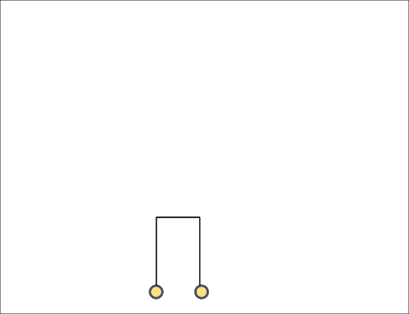
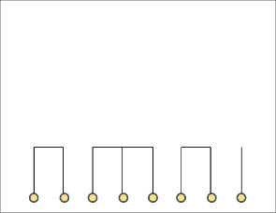
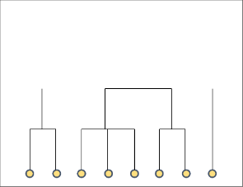
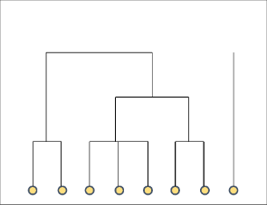
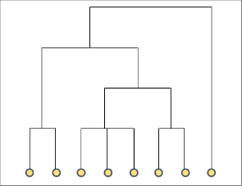
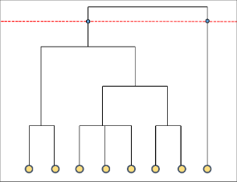
2.1. Hierarchical Method
UNIT 02
Hierarchical clustering algorithm
(a)
(b)
(c)
(d)
(e)
(f)
1) First, group together the nearest observations and get small clusters: (a) ~ (b).
2) Group the nearest clusters together to form larger clusters: (c).
3) Repeat step 2) until all the observations are grouped together into a single cluster: (d) ~ (e).
4) Cut the dendrogram at an appropriate height such that we get the desired number of clusters: (f).
Notes:
Here, the hierarchical clustering algorithm is illustrated.
The advantage of hierarchical clustering algorithm is to draw the dendrogram (a tool for visualizing hierarchical clustering as binary tree shape), which creates a significant classification system to help us to understand clustering results.

Slide 21
2.1. Hierarchical Method
UNIT 02
Hierarchical clustering algorithm
How do we measure the inter-cluster distances?
Single linkage
Complete linkage
Average linkage
Notes:
When we merge small clusters into larger ones, we can apply different criteria to measure the inter-cluster distances.
+Single linkage: measures the distance between the closest points.
+Complete linkage: measures the distance between the most distant points.
+Average linkage: measures the distance between the centers.

Slide 22
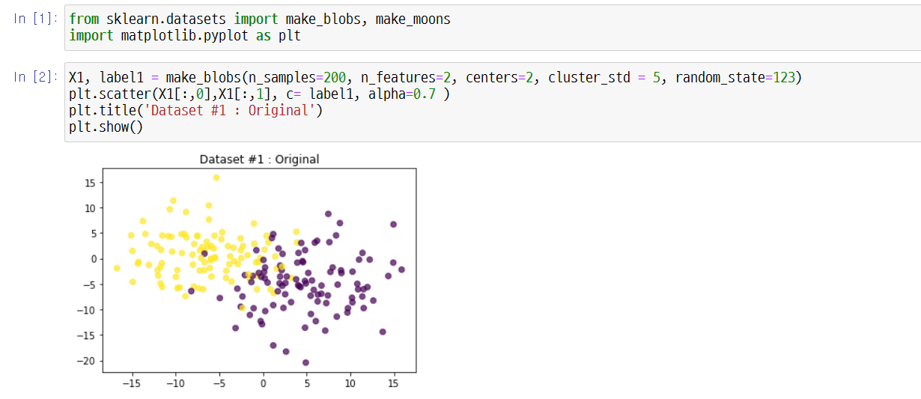
2.1. Hierarchical Method
UNIT 02
Apply agglomerative clustering and visualize
Dataset #1

Slide 23
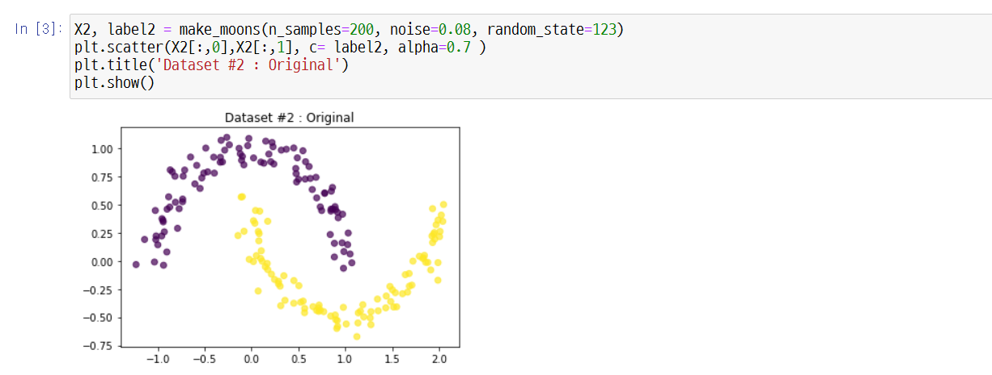
2.1. Hierarchical Method
UNIT 02
Dataset #2

Slide 24
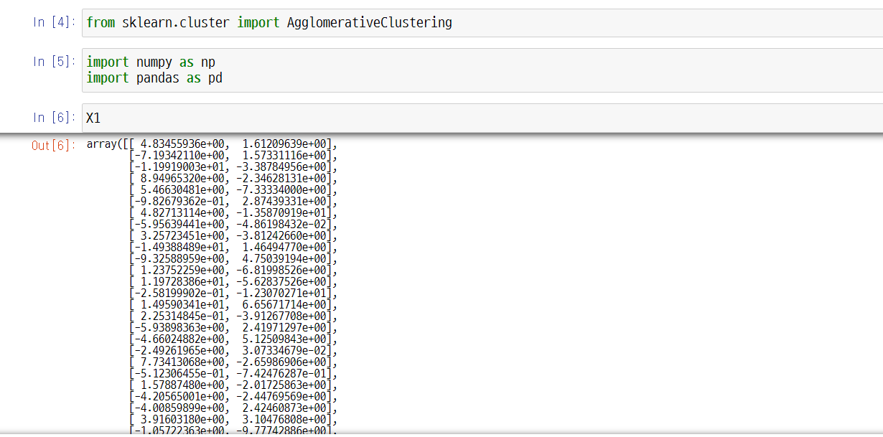
2.1. Hierarchical Method
UNIT 02
Clusters

Slide 25
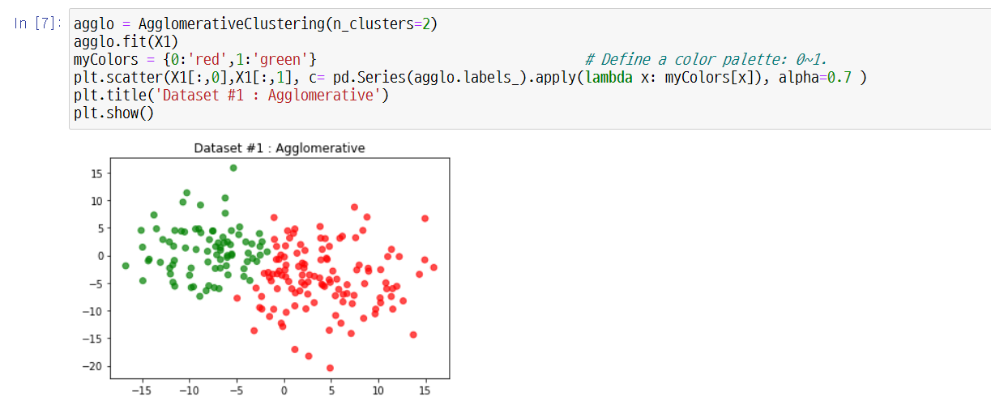
2.1. Hierarchical Method
UNIT 02
Dataset #1 and two clusters

Slide 26
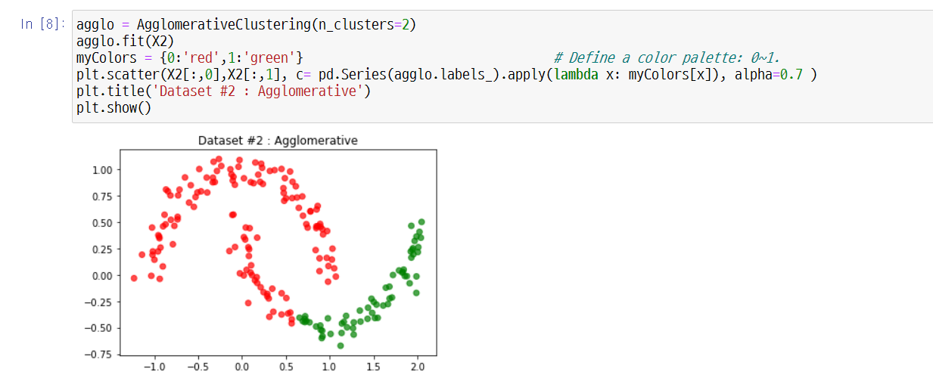
2.1. Hierarchical Method
UNIT 02
Dataset #2 and two clusters

Slide 27
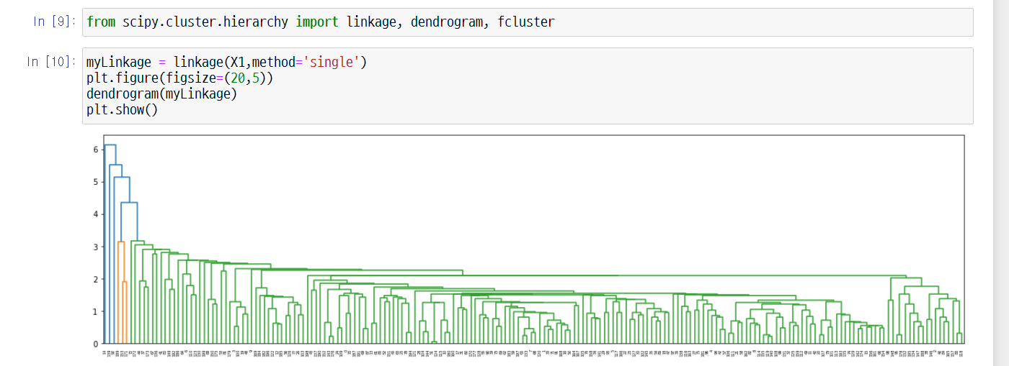
2.1. Hierarchical Method
UNIT 02
Applying hierarchical clustering and visualizing
Dataset #1 and show dendrogram
Cluster hierarchically using single linkage

Slide 28
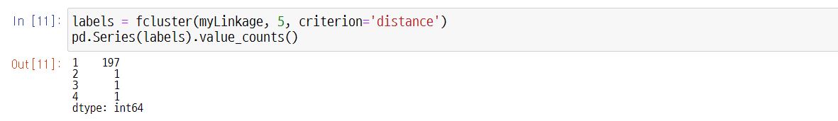
2.1. Hierarchical Method
UNIT 02
Applying hierarchical clustering and visualizing
Dataset #1 and clusters by cutting the dendrogram
Cut at the height (distance) = 5 (change this value at will).

Slide 29
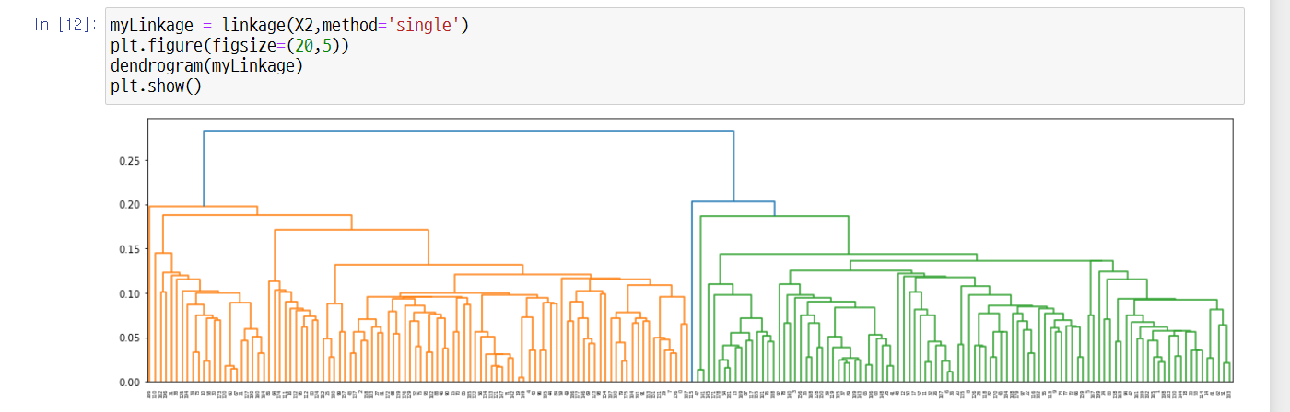
2.1. Hierarchical Method
UNIT 02
Applying hierarchical clustering and visualizing
Dataset #2 and dendrogram
Cluster hierarchically using single linkage

Slide 30
2.1. Hierarchical Method
UNIT 02
Applying hierarchical clustering and visualizing
Dataset #2 and clusters by cutting the dendrogram
Cut at the height (distance) = 0.23 (change this value at will).

Slide 31
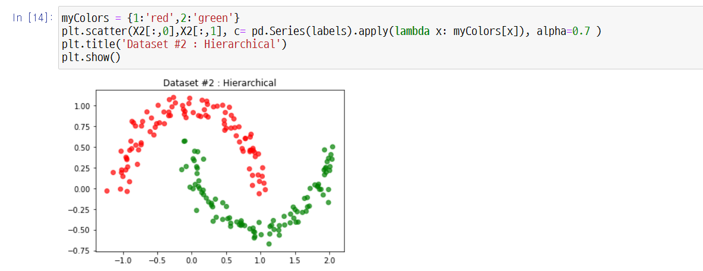
2.1. Hierarchical Method
UNIT 02
Applying hierarchical clustering and visualizing
Define a color palette: 1~2.

Slide 32
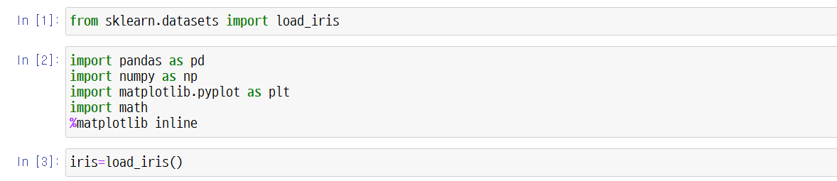
2.1. Hierarchical Method
UNIT 02
Creating hierarchical clustering
Use the agglomerative method to create hierarchical clustering.
Import the iris data.

Slide 33
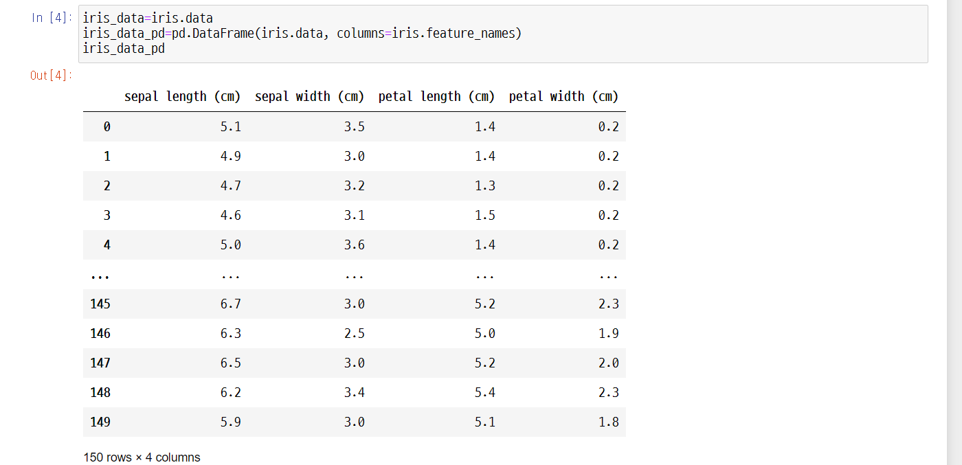
2.1. Hierarchical Method
UNIT 02
Creating hierarchical clustering

Slide 34
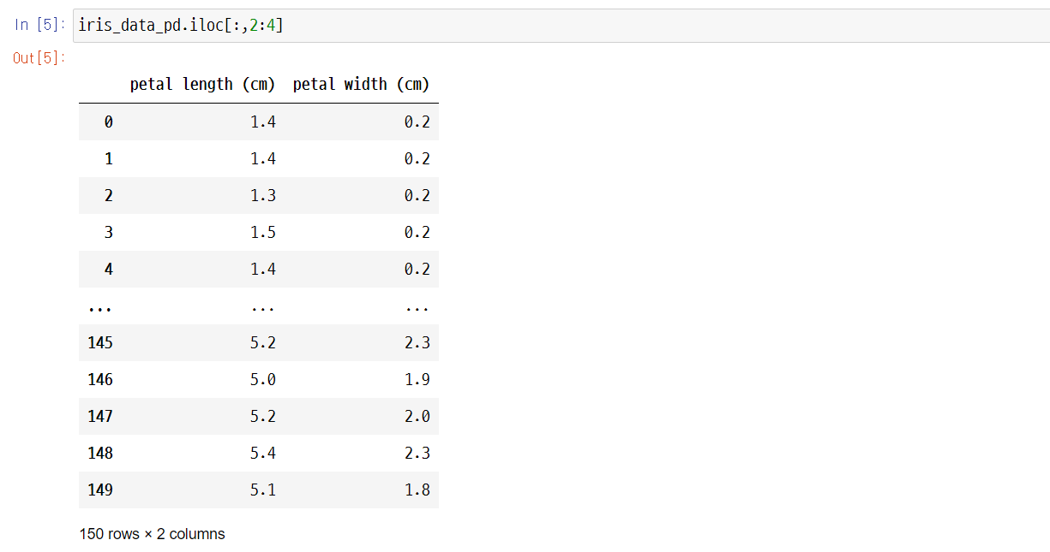
2.1. Hierarchical Method
UNIT 02
Creating hierarchical clustering

Slide 35
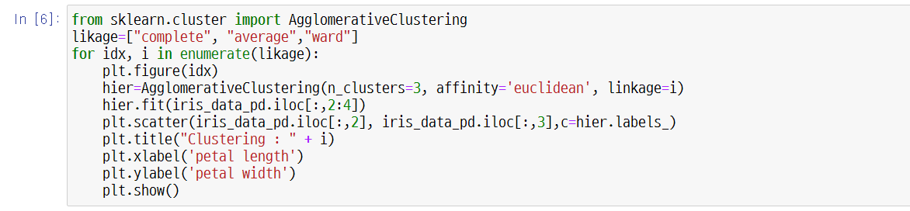
2.1. Hierarchical Method
UNIT 02
Creating hierarchical clustering
To use the ’petal length’ and ’petal width’ columns, import the sklearn agglomerative clustering, which is supported by the sklearn.clustering package.
The distance measurement criteria between clustering can be set with the linkage parameter, which only supports ward, complete, and average. Check out how all three cases are used.

Slide 36
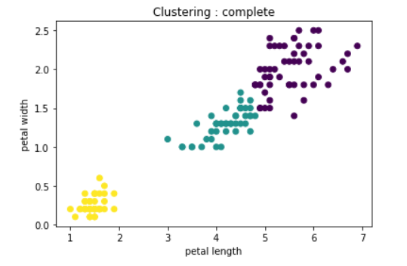
2.1. Hierarchical Method
UNIT 02
Creating hierarchical clustering
To use the ’petal length’ and ’petal width’ columns, import the sklearn agglomerative clustering, which is supported by the sklearn.clustering package.
The distance measurement criteria between clustering can be set with the linkage parameter, which only supports ward, complete, and average. Check out how all three cases are used.

Slide 37
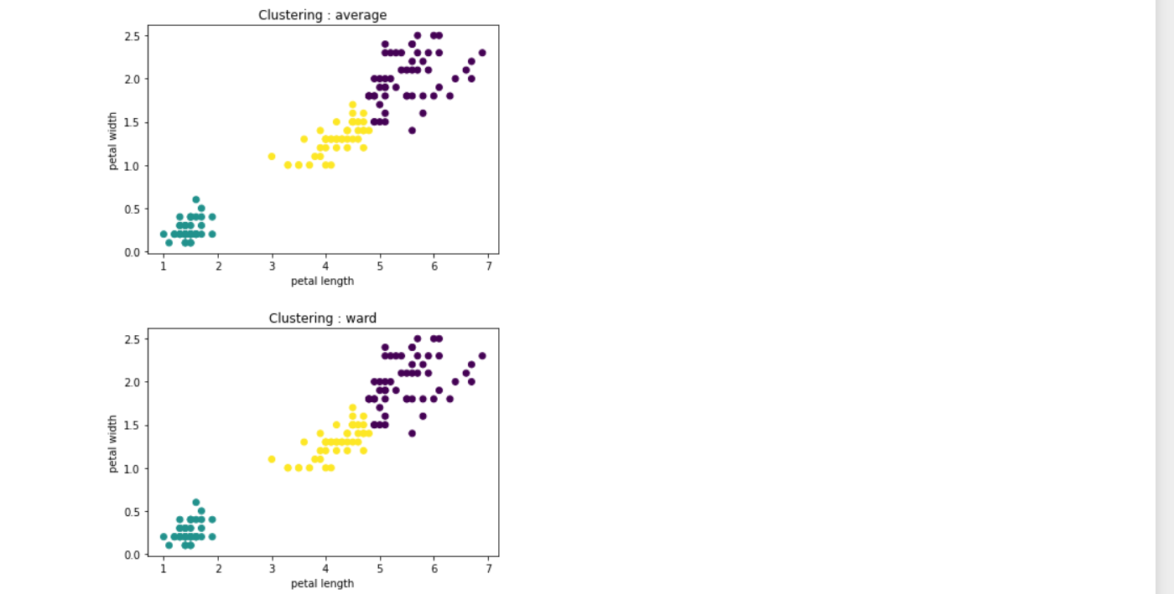
2.1. Hierarchical Method
UNIT 02
Creating hierarchical clustering
To use the ’petal length’ and ’petal width’ columns, import the sklearn agglomerative clustering, which is supported by the sklearn.clustering package.
The distance measurement criteria between clustering can be set with the linkage parameter, which only supports ward, complete, and average. Check out how all three cases are used.

Slide 38
2.1. Hierarchical Method
UNIT 02
Creating hierarchical clustering
Use Scikit-learn to confirm the clustering result. You may want to check how the tree is created, but this package does not provide this function.
Instead, use the SciPy package for clustering and drawing a tree.
As provided previously, implement the complete linkage.

Slide 39
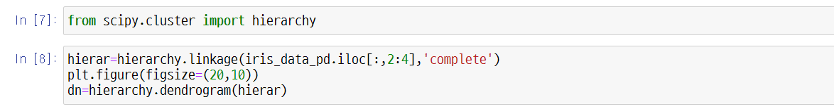
2.1. Hierarchical Method
UNIT 02
Creating hierarchical clustering

Slide 40
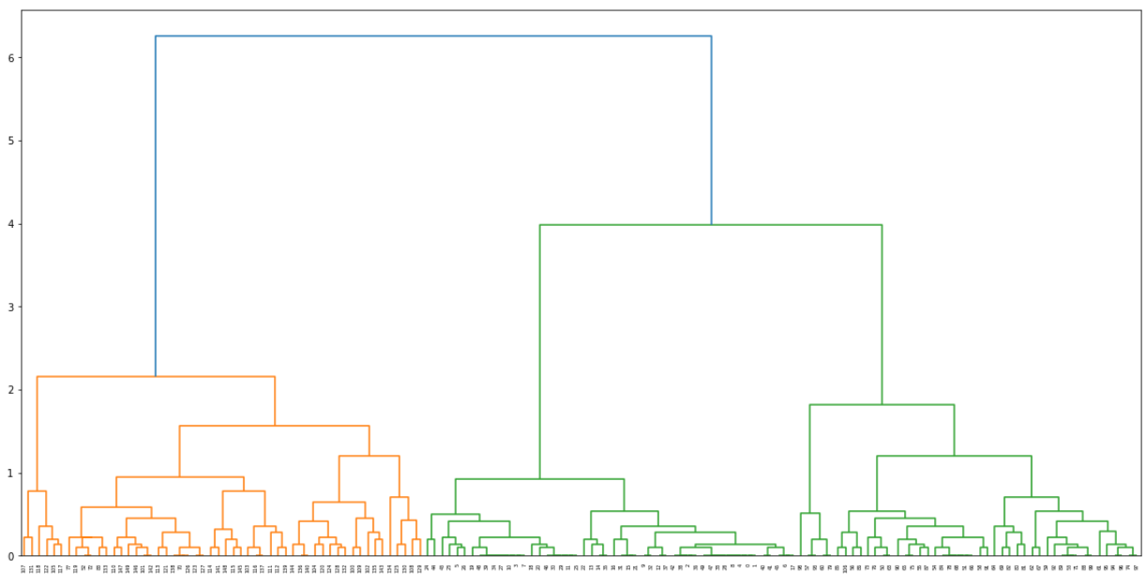
2.1. Hierarchical Method
UNIT 02
Creating hierarchical clustering

Slide 41
2.1. Hierarchical Method
UNIT 02
Creating hierarchical clustering

Slide 42
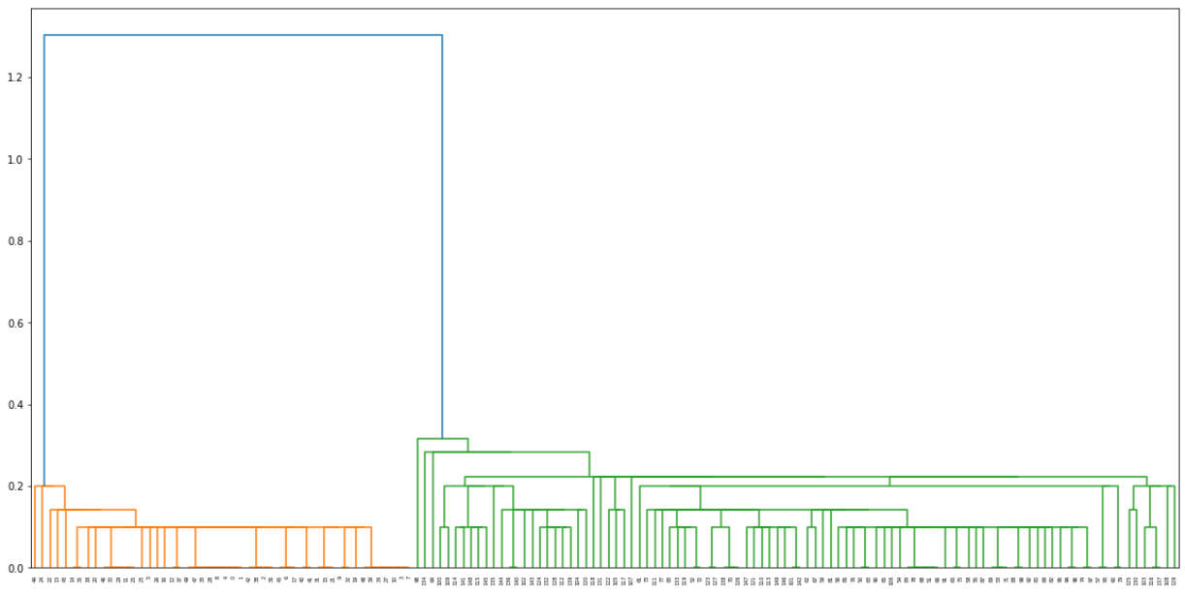
2.1. Hierarchical Method
UNIT 02
Creating hierarchical clustering

Slide 43
2.1. Hierarchical Method
UNIT 02
Creating hierarchical clustering
Unlike complete linkage, single linkage creates hierarchical clustering from the closest elements. It is highly different from K-means, such that the single linkage creates a tree-shaped hierarchical cluster.
It is important to select an appropriate linkage type to create a suitable model for the data condition.

Slide 44
Unit 3.
Non-hierarchical Clustering
3.1. K-means Clustering
3.2. Other Clustering Methods

Slide 45
3.1. K-means Clustering
UNIT 03
K-Means Clustering
About the k-means clustering
There is one ore more explanatory variables 𝑋1 , 𝑋2 , …, 𝑋𝑑.
There is no response variable. Hence, this is a unsupervised learning algorithm.
Purposes of the k-means clustering
Cluster the observations in 𝑘 clusters.
Find the centroids (cluster means) that characterize the clusters.
Notes:
K-means clustering is a unsupervised learning algorithm.
There are only explanatory variables.

Slide 46
3.1. K-means Clustering
UNIT 03
Pros
Intuitive interpretation of the results
Quick and easy
Cons
Sensitive to the noise and outliers
Cluster boundaries can only be linear.
Notes:
K-means is a quick and easy-to-understand algorithm.
The internal mechanism is straightforward.
However, it has clear limitations as outlined here.

Slide 47
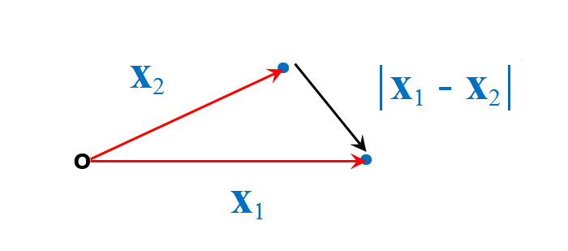
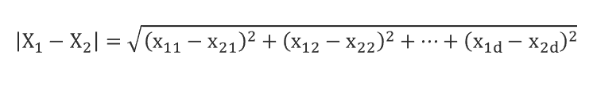
3.1. K-means Clustering
UNIT 03
Distance metric
Euclidean distance: it is the modulus of the difference between two position vectors.
$$\left|X_{1}−X_{2}\right|=\sqrt{{\left(x_{11}−x_{21}\right)}^{2}+{\left(x_{12}−x_{22}\right)}^{2}+…+{\left(x_{1d}−x_{2d}\right)}^{2}}$$
Notes:
First of all, we should define the distance metric.
The physical distance metric we are all familiar with has a name: “Euclidean distance.”
Here, we give it a formal definition.

Slide 48
3.1. K-means Clustering
UNIT 03
Distance metric
For numeric variables:
Euclidean, Standardized, Mahalanobis, Chebyshev, Canberra, Manhattan, Minkowski, etc.
For categorical variables:
Jackard, etc.
Black: Euclidean / Colored: Manhattan
Notes:
There are a bunch of other distance metrics.
Strictly speaking they are not “distance” in the physics sense.
They should be understood as measures of “closeness.”

Slide 49
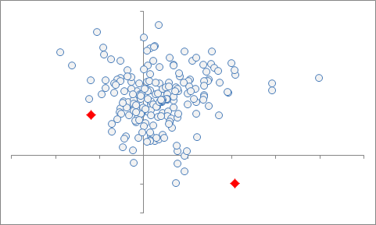
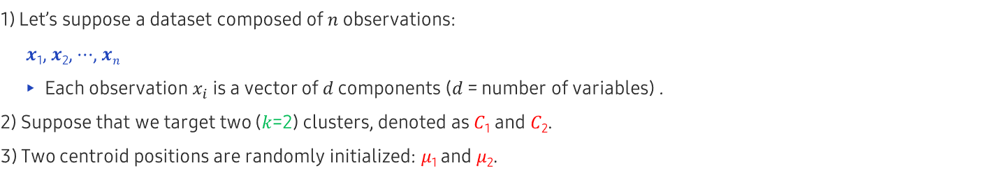
3.1. K-means Clustering
UNIT 03
Standard algorithm
1) Let’s suppose a dataset composed of 𝑛 observations:
𝒙₁, 𝒙₂, ⋯, 𝒙_{𝑛}
Each observation $x_{i}$ is a vector of 𝑑 components (𝑑 = number of variables) .
2) Suppose that we target two (𝑘=2) clusters, denoted as 𝐶₁ and 𝐶₂.
3) Two centroid positions are randomly initialized: 𝜇₁ and 𝜇₂.
Notes:
Here, the so-called standard algorithm of k-means clustering is explained step by step.
We assume an example where we would like to find two clusters.

Slide 50
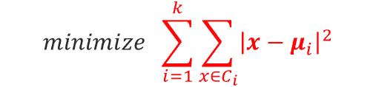
3.1. K-means Clustering
UNIT 03
Standard algorithm
4) Assign the observations to the nearest centroids.
5) Update the centroid positions, such that the sum of square distances between the observations and the nearest centroids gets smaller.
6) Repeat from step 4) until the centroids converge to their final positions.
$$minimize \sum_{i=1}^{k}{\sum_{x∈C_{i}}{{\left|x−μ_{i}\right|}^{2}}}$$
Notes:
Here, the step by step explanation of the standard algorithm continues.
It is important to notice that this algorithm is “iterative”: we converge to the solution in several small steps.

Slide 51
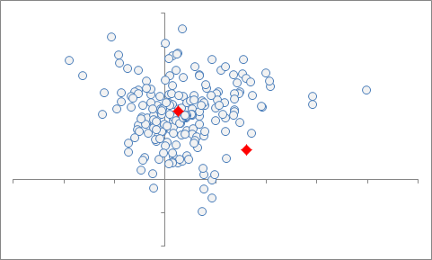
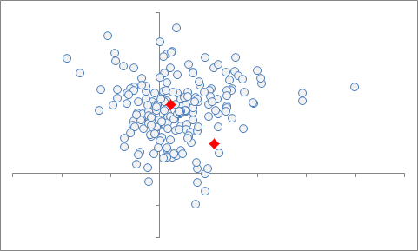
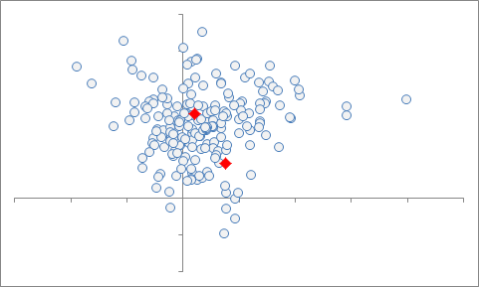
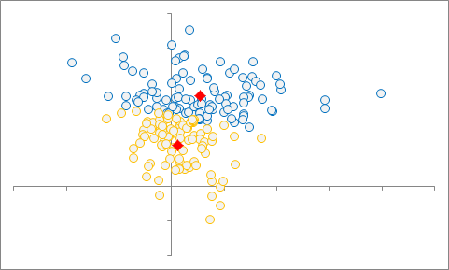
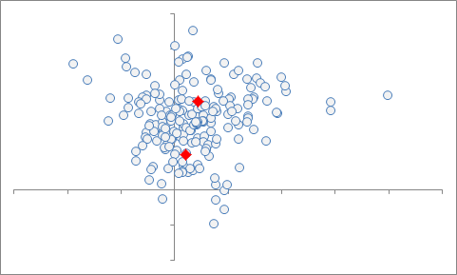

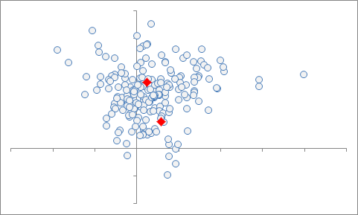
3.1. K-means Clustering
UNIT 03
Standard algorithm
Start
Finish
Notes:
The standard algorithm is illustrated with an example where two clusters are sought.
We can easily generalize this to an arbitrary number of clusters.

Slide 52
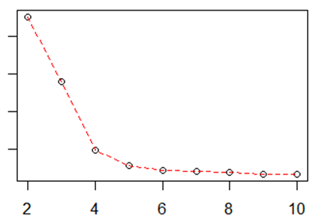
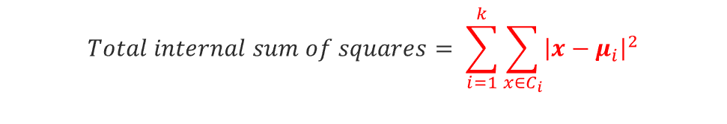
3.1. K-means Clustering
UNIT 03
Standard algorithm
A question: how do we find the optimal number of clusters?
Let’s define the sum of square distances between the observations and the nearest centroids as:
Plot the “Total internal sum of squares” vs “N# of clusters” and find the inflexion point. ← “Elbow”
$$Total internal sum of squares= \sum_{i=1}^{k}{\sum_{x∈C_{i}}{{\left|x−μ_{i}\right|}^{2}}}$$
Total internal SS
N# of Clusters
Notes:
Here, the so-called “Elbow” method is explained.
Using this method, we can find the optimal number of clusters.
There is another method based on the “silhouette scores” to optimize the number of clusters.

Slide 53

3.1. K-means Clustering
UNIT 03
Coding Exercise #0401
Follow practice steps on 'ex_0401.ipynb' file
Notes:
WHAT THIS PRACTICE ABOUT
In this practice, we apply k-means clustering to a simulated dataset.
PRACTICE INSTRUCTION
Click Window button.
Search the “anaconda prompt” and Run.
Type the command "jupyter notebook" and press Enter.
In Jupyter Notebook, go to the folder containing the practice files. (If you don’t have practice files yet, ask your instructor)
Click Coding Exercise folder.
Click the ex_0401.ipynb file.
Review the examples on the topics below: A. K-Means clustering with simulated data. i. Generate simulated data and visualize. ii. Apply k-means clustering and visualize.
(Optional) Use the blank cell at the bottom to practice your own personal needs.

Slide 54
3.1. K-means Clustering
UNIT 03
Coding Exercise #0402
Follow practice steps on 'ex_0402.ipynb' file
Notes:
WHAT THIS PRACTICE ABOUT
In this practice, we apply k-means clustering to a real dataset.
PRACTICE INSTRUCTION
Start Jupyter Notebook. (Refer to steps 1-3 of Coding Exercise # 0401.)
In Jupyter Notebook, click the ex_0402.ipynb files in the Coding Exercise folder.
Review the examples on the topics below: A. K-Means clustering with real data i. Load the 'Iris' dataset from Seaborn ii. Apply k-means iii. Visualize iv. Prediction based on what we have learned
(Optional) Use the blank cell at the bottom to practice your own personal needs.

Slide 55
Unit 3.
Non-hierarchical Clustering
3.1. K-means Clustering
3.2. Other Clustering Methods

Slide 56
3.2. Other Clustering Methods
UNIT 03
Other clustering methods
K-medoids clustering
K-medoids clustering is the advanced version of the K-means clustering method. It uses all types of similarity and dissimilarity measures. Moreover, it is advantageous for noise or outlier processing because it designates the cluster center using actual data set values rather than random dots on plane coordinates.
DBSCAN (Density Based Spatial Clustering of Application with Noise)
K-means clustering method calculates the average of K-clusters and distances between each data point for clustering. On the other hand, DBSCAN applies density to create the same group of data sets linked with constant density. It is a clustering method that is advantageous for identifying noise and outliers.
Gaussian Mixture Model
It is a probability-based clustering analysis that predicts the parameter using the EM (Expectation Maximization) or MCMC (Markov Chain Monte Carlo) algorithms.
Notes:
Likewise, there are many different kinds of clustering methods, but K-means clustering is mostly used in reality because it provides convenient calculation and quick processing of massive data.

Slide 57
3.2. Other Clustering Methods
UNIT 03
Density-based spatial clustering of applications with noise (DBSCAN)
About the DBSCAN
The most common algorithm in density clustering is the Density-based Spatial Clustering of Applications with Noise (DBSCAN) algorithm. Similar to K-means clustering, DBSCAN clustering is affected by data distribution.
While K-means clustering creates clusters according to the distribution using the standard data, the DBSCAN clustering is affected by the density of each data. In other words, it assumes that the data included in the same cluster would have high density.
We are going to look at how the DBSCAN determines density.

Slide 58
3.2. Other Clustering Methods
UNIT 03
About the DBSCAN
This is a unsupervised learning algorithm; there are only 𝑋 variables.
It was developed in 1996.
It allows density-based clustering.
Pros
It can reveal structures that the k-means and hierarchical clustering cannot.
Cons
Hyperparameters eps and minPts must be specified.
It is hard to get stable clusters in case the dense regions overlap.
Notes:
DBSCAN clustering algorithm is introduced.
This is not distance based as k-means or hierarchical, but a density based algorithm.
There are two hyperparameters that should be tuned.
There are several pros and cons.

Slide 59
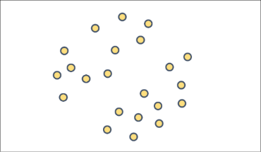
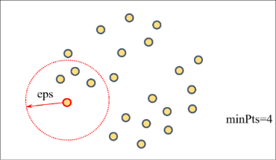
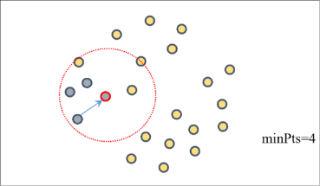
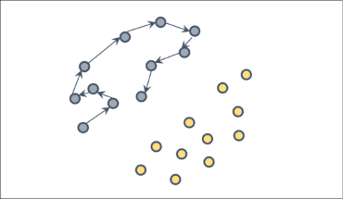
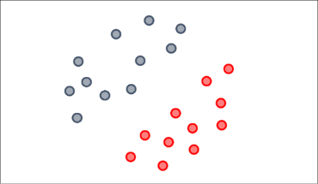
3.2. Other Clustering Methods
UNIT 03
DBSCAN algorithm
(a)
(b)
(c)
(d)
(e)
1) Suppose that the observations are distributed as in (a).
2) From a point, count the points within a radius eps and look around: (b).
3) If there are more than minPts points within the circle, include them in the same cluster: (b).
4) Then move on to the next point and repeat from step 2) until all the points are exhausted: (c)~(d).
5) Move on to another point that has not been clustered yet. Repeat from step 2): (e).
Notes:
The DBSCAN algorithm is illustrated step by step with an example.

Slide 60
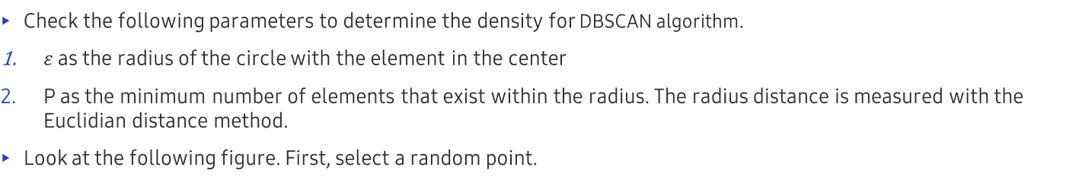
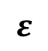
3.2. Other Clustering Methods
UNIT 03
How to determine density for DBSCAN algorithm
Check the following parameters to determine the density for DBSCAN algorithm.
$ε$ as the radius of the circle with the element in the center
P as the minimum number of elements that exist within the radius. The radius distance is measured with the Euclidian distance method.
Look at the following figure. First, select a random point.
P:5
$$ε$$

Slide 61
3.2. Other Clustering Methods
UNIT 03
How to determine density for DBSCAN algorithm
The randomly selected point is designated at a red dot, as shown in the figure in the previous slide.
The circle is centered on the red dot and has a radius of ε. Check if the number of elements inside the circle is the same as P or greater than P.
If it is the same or greater than P, then the red dot becomes a core object, and the circle is created as a cluster. If the value is smaller than P, the red dot is defined as noise.
In the figure, the elements in the red circle are six green dots. P equals 5, so the minimum number of elements that should exist within the radius is satisfied.
Thus, the rod dot becomes a core object, and the red circle becomes a cluster. Now, move on to other elements. Select one of the elements in the circle other than the core object.
Let’s look at the new dot in the next figure.

Slide 62
3.2. Other Clustering Methods
UNIT 03
How to determine density for DBSCAN algorithm
P=5
Blue circle is the existing cluster, and a new dot is designated within the radius. When creating a circle with the red dot in the center, only three elements are inside it.
The P value is 5, so the number of elements inside the circle is less than P. Thus, this dot cannot become the core object. Instead, it is defined as noise.
Move on to another dot within the radius.

Slide 63
3.2. Other Clustering Methods
UNIT 03
How to determine density for DBSCAN algorithm
P=5
Now, there are 5 elements in the red circle. It is the same as the P value, so this red dot is recognized as a core object.
It is possible to create a cluster, but make sure to consider if this element was included in the previous cluster, as it is now classified as a new core object.
If included in the previous cluster, do not create a new cluster but expand the existing cluster. If it is not relevant to the previous cluster, a new cluster will be created using the red dot as a new core object.
In the figure, the red dot is an element presented in the blue circle, which is the previous cluster. Since it is included in the previously created cluster, the previous cluster is expanded without making a new cluster.

Slide 64
3.2. Other Clustering Methods
UNIT 03
How to determine density for DBSCAN algorithm
P=5
This is the expanded cluster.
The DBSCAN algorithm aims to check every dot by repeating the same process over and over. After completing all processes, the data cluster looks as follows.

Slide 65
3.2. Other Clustering Methods
UNIT 03
How to determine density for DBSCAN algorithm
P:5
The black dots are the core objects.
Likewise, the DBSCAN takes only two parameters and uses them to create a cluster.
Thus, no other parameters are required besides ε and P values. This is how the density is determined in the DBSCAN algorithm.

Slide 66
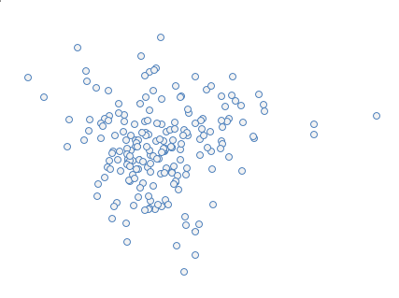
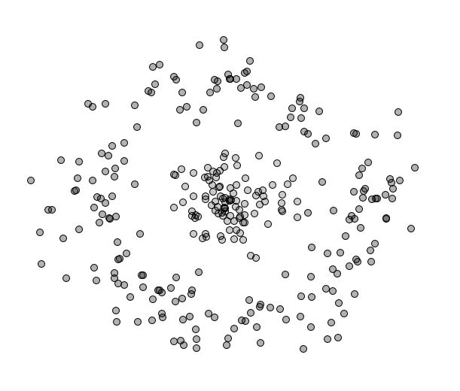
3.2. Other Clustering Methods
UNIT 03
Clustering
Question: which clustering algorithms are suitable for the following cases?
(a)
(b)
Notes:
Short answer below:
+In (a):
DBSCAN will create a big cluster around the middle leaving out the points in the periphery as unclustered outliers.
If we desire clusters of even size, we would rather go with k-means.
+In (b):
We can visually identify a dense region at the “core” and another dense region at the “shell.”
k-means will not be able to distinguish them as separate clusters.
DBSCAN, if well tuned, potentially would work.

Slide 67
3.2. Other Clustering Methods
UNIT 03
Coding Exercise #0403
Follow practice steps on 'ex_0403.ipynb' file
Notes:
WHAT THIS PRACTICE ABOUT
In this practice, we compare different clustering algorithms and discuss pros and cons.
PRACTICE INSTRUCTION
Start Jupyter Notebook. (Refer to steps 1-3 of Coding Exercise # 0401.)
In Jupyter Notebook, click the ex_0403.ipynb files in the Coding Exercise folder.
Review the examples on the topics below: A. Compare clustering algorithms. i. Generate simulated data and visualize. ii. Apply k-means clustering and visualize. iii. Apply agglomerative clustering and visualize iv. Apply hierarchical clustering and visualize. v. Apply DBSCAN and visualize
(Optional) Use the blank cell at the bottom to practice your own personal needs.

Slide 68
Unit 4.
Linear Factor Model for Dimensionality Reduction
4.1. Principal Component Analysis
4.2. Applications of Principal Components

Slide 69
4.1. Principal component Analysis
UNIT 04
Principal Component Analysis
Purposes of the principal component analysis (PCA)
Transform a set of correlated variables into another set of uncorrelated variables.
Get a new set of orthogonal vectors (principal components or PCs).
Order the new variables from the largest to the smallest variance.
Pros
Many data science applications: preprocessing, modeling, dimensional reduction, visualization, etc.
Cons
It is difficult to interpret because PCs are obtained by linear combinations of the original features.
Notes:
Here, the purpose and benefits of the PCA are outlined.
The main shortcoming of the principal components lies in the fact that they are hard to interpret intuitively.

Slide 70

4.1. Principal component Analysis
UNIT 04
Terminology
a) Loading
Normalized principal component (PC)
There are as many loading vectors as the number of variables.
b) Variance $σ^{2}$ (or standard deviation 𝜎)
The principal components have associated variances.
c) Transformed scores
Raw scores (original observations) represented using the PCs as new coordinate axes.
Notes:
The related terminologies are explained.

Slide 71

4.1. Principal component Analysis
UNIT 04
Principal components
Let’s suppose that there are 𝑘 variables or features $X_{1},X_{2},…,X_{k}$.
Then, the ${PC}_{1},{PC}_{2},…,{PC}_{k}$ are linear combinations of the original features:
${PC}_{i}$=$α_{1,i}X_{1}+α_{2,i}X_{2}+…+α_{k,i}X_{k}$
Conversely, the original features can be expressed in terms of the PCs:
$X_{i}$=$β_{1,i}{PC}_{1}+β_{2,i}{PC}_{2}+…+β_{k,i}{PC}_{k}$
Notes:
In the essence, a principal component (PC) is a linear combination of the original features or variables.
Conversely, the original features can be expressed as linear combinations of the PCs.

Slide 72



4.1. Principal component Analysis
UNIT 04
Principal component and variance
Suppose a dataset with two variables that can be conveniently visualized on a plane:
$$X_{2}$$
$$X_{1}$$
Notes:
This is an example with two variables: $X_{1}$ and $X_{2}$.

Slide 73



4.1. Principal component Analysis
UNIT 04
Principal component and variance
We can find the 𝑃𝐶1 and 𝑃𝐶2 that are orthogonal to each other.
$$X_{2}$$
$$X_{1}$$
Notes:
We can find the ${PC}_{1}$ and ${PC}_{2}$ that are orthogonal to each other.

Slide 74






4.1. Principal component Analysis
UNIT 04
Principal component and variance
𝑃𝐶1 is the direction of the largest variance, while 𝑃𝐶2 is the direction of the next largest variance.
$$X_{2}$$
$$X_{2}$$
$$X_{1}$$
$$σ_{2}$$
$$X_{1}$$
$$σ_{1}$$
So, we have 𝜎₁ > 𝜎₂.
Notes:
Here, we interpret what the ${PC}_{1}$ and ${PC}_{2}$ represent.

Slide 75



4.1. Principal component Analysis
UNIT 04
Transformed scores
The observations can be represented using the 𝑃𝐶1 and 𝑃𝐶2 as new coordinate axes.
$${PC}_{2}$$
$${PC}_{1}$$
Notes:
Here, we made a rotation (transformation) so that the coordinate axes are now ${PC}_{1}$ and ${PC}_{2}$.

Slide 76





4.1. Principal component Analysis
UNIT 04
Cumulative variance
As the principal components can be regarded as independent variables, the total variance is:
$$σ_{total}^{2}=σ_{1}^{2}+σ_{2}^{2}+σ_{3}^{2}+…$$
So, we can calculate the cumulative variance ratios (CVRs):
$${CVR}_{1}=\frac{σ_{1}^{2}}{σ_{total}^{2}}$$
CVR
1
$${CVR}_{2}=\frac{σ_{1}^{2}+σ_{2}^{2}}{σ_{total}^{2}}$$
$${CVR}_{3}=\frac{σ_{1}^{2}+σ_{2}^{2}+σ_{3}^{2}}{σ_{total}^{2}}$$
$$⋮$$
0
Number of PCs
Notes:
We can gather the variances along the principal components and analyze.
As we accumulate the variances, the cumulative variance ratio approaches one.

Slide 77

4.1. Principal component Analysis
UNIT 04
Calculating the principal components
The PCs can also be obtained by eigenvalue decomposition (ED) of the covariance matrix.
The PCs can be calculated by singular value decomposition (SVD) of the data matrix.
If we standardize the variables, we would have the correlation instead of the covariance.
A covariance matrix and a correlation matrix
Ex
$\left[\begin{matrix}\begin{matrix}σ_{1}^{2} & σ_{12} \\ σ_{21} & σ_{2}^{2}\end{matrix} & \begin{matrix}σ_{13} & σ_{14} \\ σ_{23} & σ_{24}\end{matrix} \\ \begin{matrix}σ_{31} & σ_{32} \\ σ_{41} & σ_{42}\end{matrix} & \begin{matrix}σ_{3}^{2} & σ_{34} \\ σ_{43} & σ_{4}^{2}\end{matrix}\end{matrix}\right]$ $\left[\begin{matrix}\begin{matrix}1 & ρ_{12} \\ ρ_{21} & 1\end{matrix} & \begin{matrix}ρ_{13} & ρ_{14} \\ ρ_{23} & ρ_{24}\end{matrix} \\ \begin{matrix}ρ_{31} & ρ_{32} \\ ρ_{41} & ρ_{42}\end{matrix} & \begin{matrix}1 & ρ_{34} \\ ρ_{43} & 1\end{matrix}\end{matrix}\right]$
“
”
In the next few slides, let’s make a detour and review the ED and SVD in detail.
Notes:
The PCs can be calculated either by eigenvalue decomposition (ED) or by singular value decomposition (SVD).
By “data matrix”, we are talking about a matrix where each row is an observation and each column is a variable.

Slide 78




4.1. Principal component Analysis
UNIT 04
Matrix Decompositions
Eigenvalue decomposition (ED)
A square matrix 𝑴 is decomposed as 𝑴=𝑸 𝜦 𝑸^{𝒕}.
All the matrices have the same size: 𝑆𝑖𝑧𝑒(𝑴)=𝑆𝑖𝑧𝑒(𝑸)=𝑆𝑖𝑧𝑒(𝜦)=𝑚×𝑚.
m
$$M$$
=
$$Q$$
⋅
$$Λ$$
⋅
$$Q^{t}$$
m
m
m
m
m
m
m
Notes:
Here, the ED is explained.

Slide 79

4.1. Principal component Analysis
UNIT 04
Eigenvalue decomposition (ED)
A square matrix 𝑴 is decomposed as 𝑴=𝑸 𝜦 𝑸^{𝒕}.
Here, 𝜦 is a diagonal matrix that contains the “eigenvalues.”
$$Λ=\left[\begin{matrix}\begin{matrix}λ_{1} & 0 \\ 0 & λ_{2}\end{matrix} & ⋯ & \begin{matrix}0 \\ 0\end{matrix} \\ ⋮ & ⋱ & ⋮ \\ \begin{matrix}0 & 0\end{matrix} & ⋯ & λ_{m}\end{matrix}\right]$$
Notes:
$Λ$ is a diagonal matrix that contains the “eigenvalues.”
In the context of the PCA, we can identify these eigenvalues as variances.

Slide 80



4.1. Principal component Analysis
UNIT 04
Eigenvalue decomposition (ED)
A square matrix 𝑴 is decomposed as 𝑴=𝑸 𝜦 𝑸^{𝒕}.
The columns of 𝑸 are the so-called “eigenvectors.”
$$Q=\left[\begin{matrix}↑ & ⋯ & ↑ \\ q_{1} & ⋯ & q_{m} \\ ↓ & ⋯ & ↓\end{matrix}\right]$$
Between an eigenvector and its eigenvalue, we have the following relation:
$${Mq}_{i}=λ_{i} q_{i}$$
Between any two eigenvectors, we have the following orthogonality condition:
$q_{i} ∙q_{j}=δ_{ij}$ ⇔ ${QQ}^{t}=Q^{t}Q=I$
Notes:
The columns of $Q$ are the so-called “eigenvectors.”
In the context of the PCA, we can identify these eigenvectors as principal components.

Slide 81




4.1. Principal component Analysis
UNIT 04
Singular value decomposition (SVD)
A matrix 𝑴 is decomposed as 𝑴=𝑼𝜮𝑽^{𝒕}.
m
$$M$$
=
$$U$$
⋅
$$Σ$$
⋅
m
m
n
$$V^{t}$$
n
n
m
n
Notes:
Here, the SVD is explained.

Slide 82

4.1. Principal component Analysis
UNIT 04
Singular value decomposition (SVD)
A matrix 𝑴 is decomposed as 𝑴=𝑼𝜮𝑽^{𝒕}.
Here, 𝜮 contains the singular values as diagonal elements.
These singular values are ordered from the largest to the smallest: 𝜎₁>𝜎₂>…>𝜎_{𝑚}
$$Σ=\left[\begin{matrix}\begin{matrix}σ_{1} & 0 \\ 0 & σ_{2}\end{matrix} & ⋯ & \begin{matrix}0 & 0 \\ 0 & 0\end{matrix} \\ ⋮ & ⋱ & ⋮ \\ \begin{matrix}0 & 0\end{matrix} & ⋯ & \begin{matrix}σ_{m} & 0\end{matrix}\end{matrix}\right]$$
Notes:
$Σ$ contains the “singular values” as diagonal elements.
In the context of the PCA, we can identify these singular values as square roots of the variances (standard deviations).

Slide 83


4.1. Principal component Analysis
UNIT 04
Singular value decomposition (SVD)
A matrix 𝑴 is decomposed as 𝑴=𝑼𝜮𝑽^{𝒕}.
The columns of 𝑼 are the “left singular vectors.”
The columns of 𝑽 are the “right singular vectors.”
$=\left[\begin{matrix}↑ & ⋯ & ↑ \\ u_{1} & ⋯ & u_{m} \\ ↓ & ⋯ & ↓\end{matrix}\right]$ $V=\left[\begin{matrix}↑ & ⋯ & ↑ \\ v_{1} & ⋯ & v_{n} \\ ↓ & ⋯ & ↓\end{matrix}\right]$
Between a set of the left and right singular vectors and their singular value, we have:
$$={M v}_{i}=σ_{i} u_{i}$$
Between any two singular vectors, we have the following orthogonality condition:
$v_{i} ∙v_{j}=δ_{ij}$ ⇔ $VV^{t}=V^{t}V=I$
$u_{i} ∙u_{j}=δ_{ij}$ ⇔ ${UU}^{t}=U^{t}U=I$
Notes:
For SVD, there are left singular vectors and right singular vectors.
Singular vectors and singular values are all related.
The left singular vectors are orthogonal among them. This can be compactly expressed as ${UU}^{t}=U^{t}U=I$.
The right singular vectors are orthogonal among them. This can be compactly expressed as $VV^{t}=V^{t}V=I$.

Slide 84



4.1. Principal component Analysis
UNIT 04
Relation between ED and SVD
1) If 𝑿 is a matrix composed of standardized scores, then we can apply SVD: 𝑿=𝑼𝜮𝑽𝒕.
2) Using the decomposed form, we can express the covariance matrix as following:
$$M=X X^{t}=U{ΣV}^{t}{\left(U{ΣV}^{t}\right)}^{t}$$
$$=U{ΣV}^{t} VΣ^{t}U^{t}$$
$$=U{ΣΣ}^{t}U^{t}$$
By orthogonality $V^{t}V=I$
We can see that 𝜮𝜮^{𝒕} is a diagonal matrix with elements equal to $σ_{i}^{2}$.
Thus, 𝜮𝜮^{𝒕} is the same as the eigenvalue matrix 𝜦.
Also, we can see that the left singular matrix 𝑼 is the same as the eigenvector matrix 𝑸.
Notes:
Here, we “connect” the ED with the SVD.

Slide 85

4.1. Principal component Analysis
UNIT 04
Relation between ED and SVD
Let’s summarize in the following table.
ED | SVD
$$X X^{t}=Q Λ Q^{t}$$ | $$X X^{t}=U{ΣΣ}^{t}U^{t}$$
$$Λ={ΣΣ}^{t}$$
$$Q=U$$
Notes:
Here, we summarize in a table the relation between ED and SVD.

Slide 86

4.1. Principal component Analysis
UNIT 04
Principal Component Analysis
Calculating the principal components
Finally, let us summarize the PCA in terms of the matrix decompositions.
 | ED | SVD
Decomposition Target | Covariance matrix $XX^{t}$ | Data matrix $X$
$$PCs$$ | Columns of the $Q$ matrix | Columns of the $U$ matrix
$σ_{i}^{2}$ or $σ_{i}$ | Diagonal elements of the $Λ$ matrix are the $σ_{i}^{2}$. | Diagonal elements of the $Σ$ matrix are the $σ_{i}$.
Notes:
Ending our linear algebra detour, we come back to the PCA.
We summarize the matrix decompositions in the context of the PCA.

Slide 87
Unit 4.
Linear Factor Model for Dimensionality Reduction
4.1. Principal Component Analysis
4.2. Applications of Principal Components

Slide 88



4.2. Applications of Principal Components
UNIT 04
Dimensional Reduction
About the dimensional reduction
The number of principal components (PCs) is equal to the number of variables, say 𝑘.
The original variables 𝑋_{𝑖} can be expressed in terms of the PCs:
$$X_{i}=β_{1,i}{PC}_{1}+β_{2,i}{PC}_{2}+…+β_{k,i}{PC}_{k}$$
$$σ_{1}^{2}>σ_{2}^{2}>σ_{3}^{2}>…>σ_{k}^{2}$$
The PCs are ordered by variance:
Thus, we can reduce dimension starting from the last PC, (𝑞 < 𝑘):
$$X_{i}≈β_{1,i}{PC}_{1}+β_{2,i}{PC}_{2}+…+β_{q,i}{PC}_{q}$$
“Reduced dimension input”
Notes:
Here, the dimensional reduction using PCs is explained.
The “reduced dimensional inputs” are approximations of the raw scores using a reduced basis set.

Slide 89
4.2. Applications of Principal Components
UNIT 04
Pros
We can simplify the data and reduce overfitting error.
We get only the most salient features.
Cons
Loss of details
It is difficult to interpret intuitively.
Notes:
The advantages and shortcoming of the dimensional reduction are listed.

Slide 90


4.2. Applications of Principal Components
UNIT 04
Dimensional reduction
Suppose a dataset with two variables that can be conveniently visualized on a plane:
$$X_{2}$$
$$X_{1}$$
Notes:
This is an example with two variables: $X_{1}$ and $X_{2}$.

Slide 91



4.2. Applications of Principal Components
UNIT 04
Dimensional reduction
The observations can be represented using the 𝑃𝐶₁ and 𝑃𝐶₂ as new coordinate axes:
$${PC}_{2}$$
$${PC}_{1}$$
$$σ_{1}$$
Notes:
If we transform (rotate) such that the ${PC}_{1}$ and ${PC}_{2}$ are the new coordinate axes, we have the largest variance along the ${PC}_{1}$ direction.

Slide 92



4.2. Applications of Principal Components
UNIT 04
Dimensional reduction
The observations can be represented using the 𝑃𝐶₁ and 𝑃𝐶₂ as new coordinate axes:
$${PC}_{2}$$
$${PC}_{1}$$
$$σ_{2}$$
Notes:
And, we have a smaller variance along the ${PC}_{2}$ direction.

Slide 93


4.2. Applications of Principal Components
UNIT 04
Dimensional reduction
We can eliminate the direction represented by 𝑃𝐶₂ that corresponds to the smaller variance:
$$×$$
$${PC}_{2}$$
$${PC}_{1}$$
Notes:
We can eliminate the direction of smaller variance, that is, ${PC}_{2}$.
This is what the dimensional reduction means.

Slide 94



4.2. Applications of Principal Components
UNIT 04
Dimensional reduction
Now, we can go back to the original coordinate system and show the “reduced dimensional input”:
$$X_{2}$$
$$X_{1}$$
Notes:
To show the effect of the dimensional reduction, we go back to the original coordinate system.

Slide 95


4.2. Applications of Principal Components
UNIT 04
Dimensional reduction
Now, we can go back to the original coordinate system and show the “reduced dimensional input”:
$$X_{2}$$
Salient feature
$$X_{1}$$
Loss of details
We can notice that details have been lost leaving only the most salient feature.
Notes:
We can clearly see that the direction of the largest variance “survived” while that of smaller variance has been eliminated.
This way we extract the most salient feature at the expense of “some details.”

Slide 96




4.2. Applications of Principal Components
UNIT 04
Dimensional reduction
$$σ_{total}^{2}=σ_{1}^{2}+σ_{2}^{2}+σ_{3}^{2}+…+σ_{k}^{2}$$
The total variance is:
Then, we can calculate the cumulative variance ratios:
CVR
$${CVR}_{1}=\frac{σ_{1}^{2}}{σ_{total}^{2}}$$
1
Target
$${CVR}_{2}=\frac{σ_{1}^{2}+σ_{2}^{2}}{σ_{total}^{2}}$$
$${CVR}_{3}=\frac{σ_{1}^{2}+σ_{2}^{2}+σ_{3}^{2}}{σ_{total}^{2}}$$
0
$$⋮$$
Number of PCs
Required
We can set a target CVR and determine the required number of PCs.
Notes:
Again, we can analyze the accumulated variance.
We can set a target for the CVR and determine the required number of PCs to reach that target.

Slide 97


4.2. Applications of Principal Components
UNIT 04
High Dimension Visualization
High dimension visualization
𝑃𝐶₁ and 𝑃𝐶₂ are the directions of the largest and the second largest variance.
𝑃𝐶₁ and 𝑃𝐶₂ define the most spread out plane on which to project the high dimensional coordinates.
$${PC}_{1}$$
$${PC}_{2}$$
It is easy to implement as it uses only the first two components of the transformed scores.
Notes:
An interesting example of application of the PCs is that of visualization.
High dimensional data is hard to visualize as is.
So, we can “project out” the data points onto a plane defined by the ${PC}_{1}$ and ${PC}_{2}$.

Slide 98




4.2. Applications of Principal Components
UNIT 04
High dimension visualization
Ex
Projected onto the original variable set
Projected onto the plane defined by ${PC}_{1}$ and ${PC}_{2}$
Notes:
In the rightmost picture where the plane is defined by the PCs, we notice that the points are spread out with little overlapping.
Also, the clusters are more clearly distinguished.
However, this technique does not always guarantee a satisfactory result.

Slide 99
4.2. Applications of Principal Components
UNIT 04
Coding Exercise #0404
Follow practice steps on 'ex_0404.ipynb' file
Notes:
WHAT THIS PRACTICE ABOUT
In this practice, we go through some applications of PCA and NMF.
PRACTICE INSTRUCTION
Start Jupyter Notebook. (Refer to steps 1-3 of Coding Exercise # 0401.)
In Jupyter Notebook, click the ex_0404.ipynb files in the Coding Exercise folder.
Review the examples on the topics below: A. Dimensional reduction with PCA. i. Read in data and explore. ii. Visualize the data. iii. Visualize the reduced dimensional input by PCA. iv. Analysis of the cumulative variance ratio (CVR). B. Dimensional reduction with NMF. i. Visualize the reduced dimensional input by NMF. C. Optimized high dimensional visualization with PCA. i. Simulate data. ii. Visualize on the plane defined by PC1 and PC2.
(Optional) Use the blank cell at the bottom to practice your own personal needs.

Slide 100

End of
Document
Samsung Innovation Campus

